Slide 1




“Uncertainty In Edible Oil Prices, Huge Challenges For Consumer Countries Like Pakistan”
Presented By
FAAD WAHEED
Chief Executive, Fauji Supreme
Director, Waheed Group of Companies
Senior Vice President ICCI

Slide 2
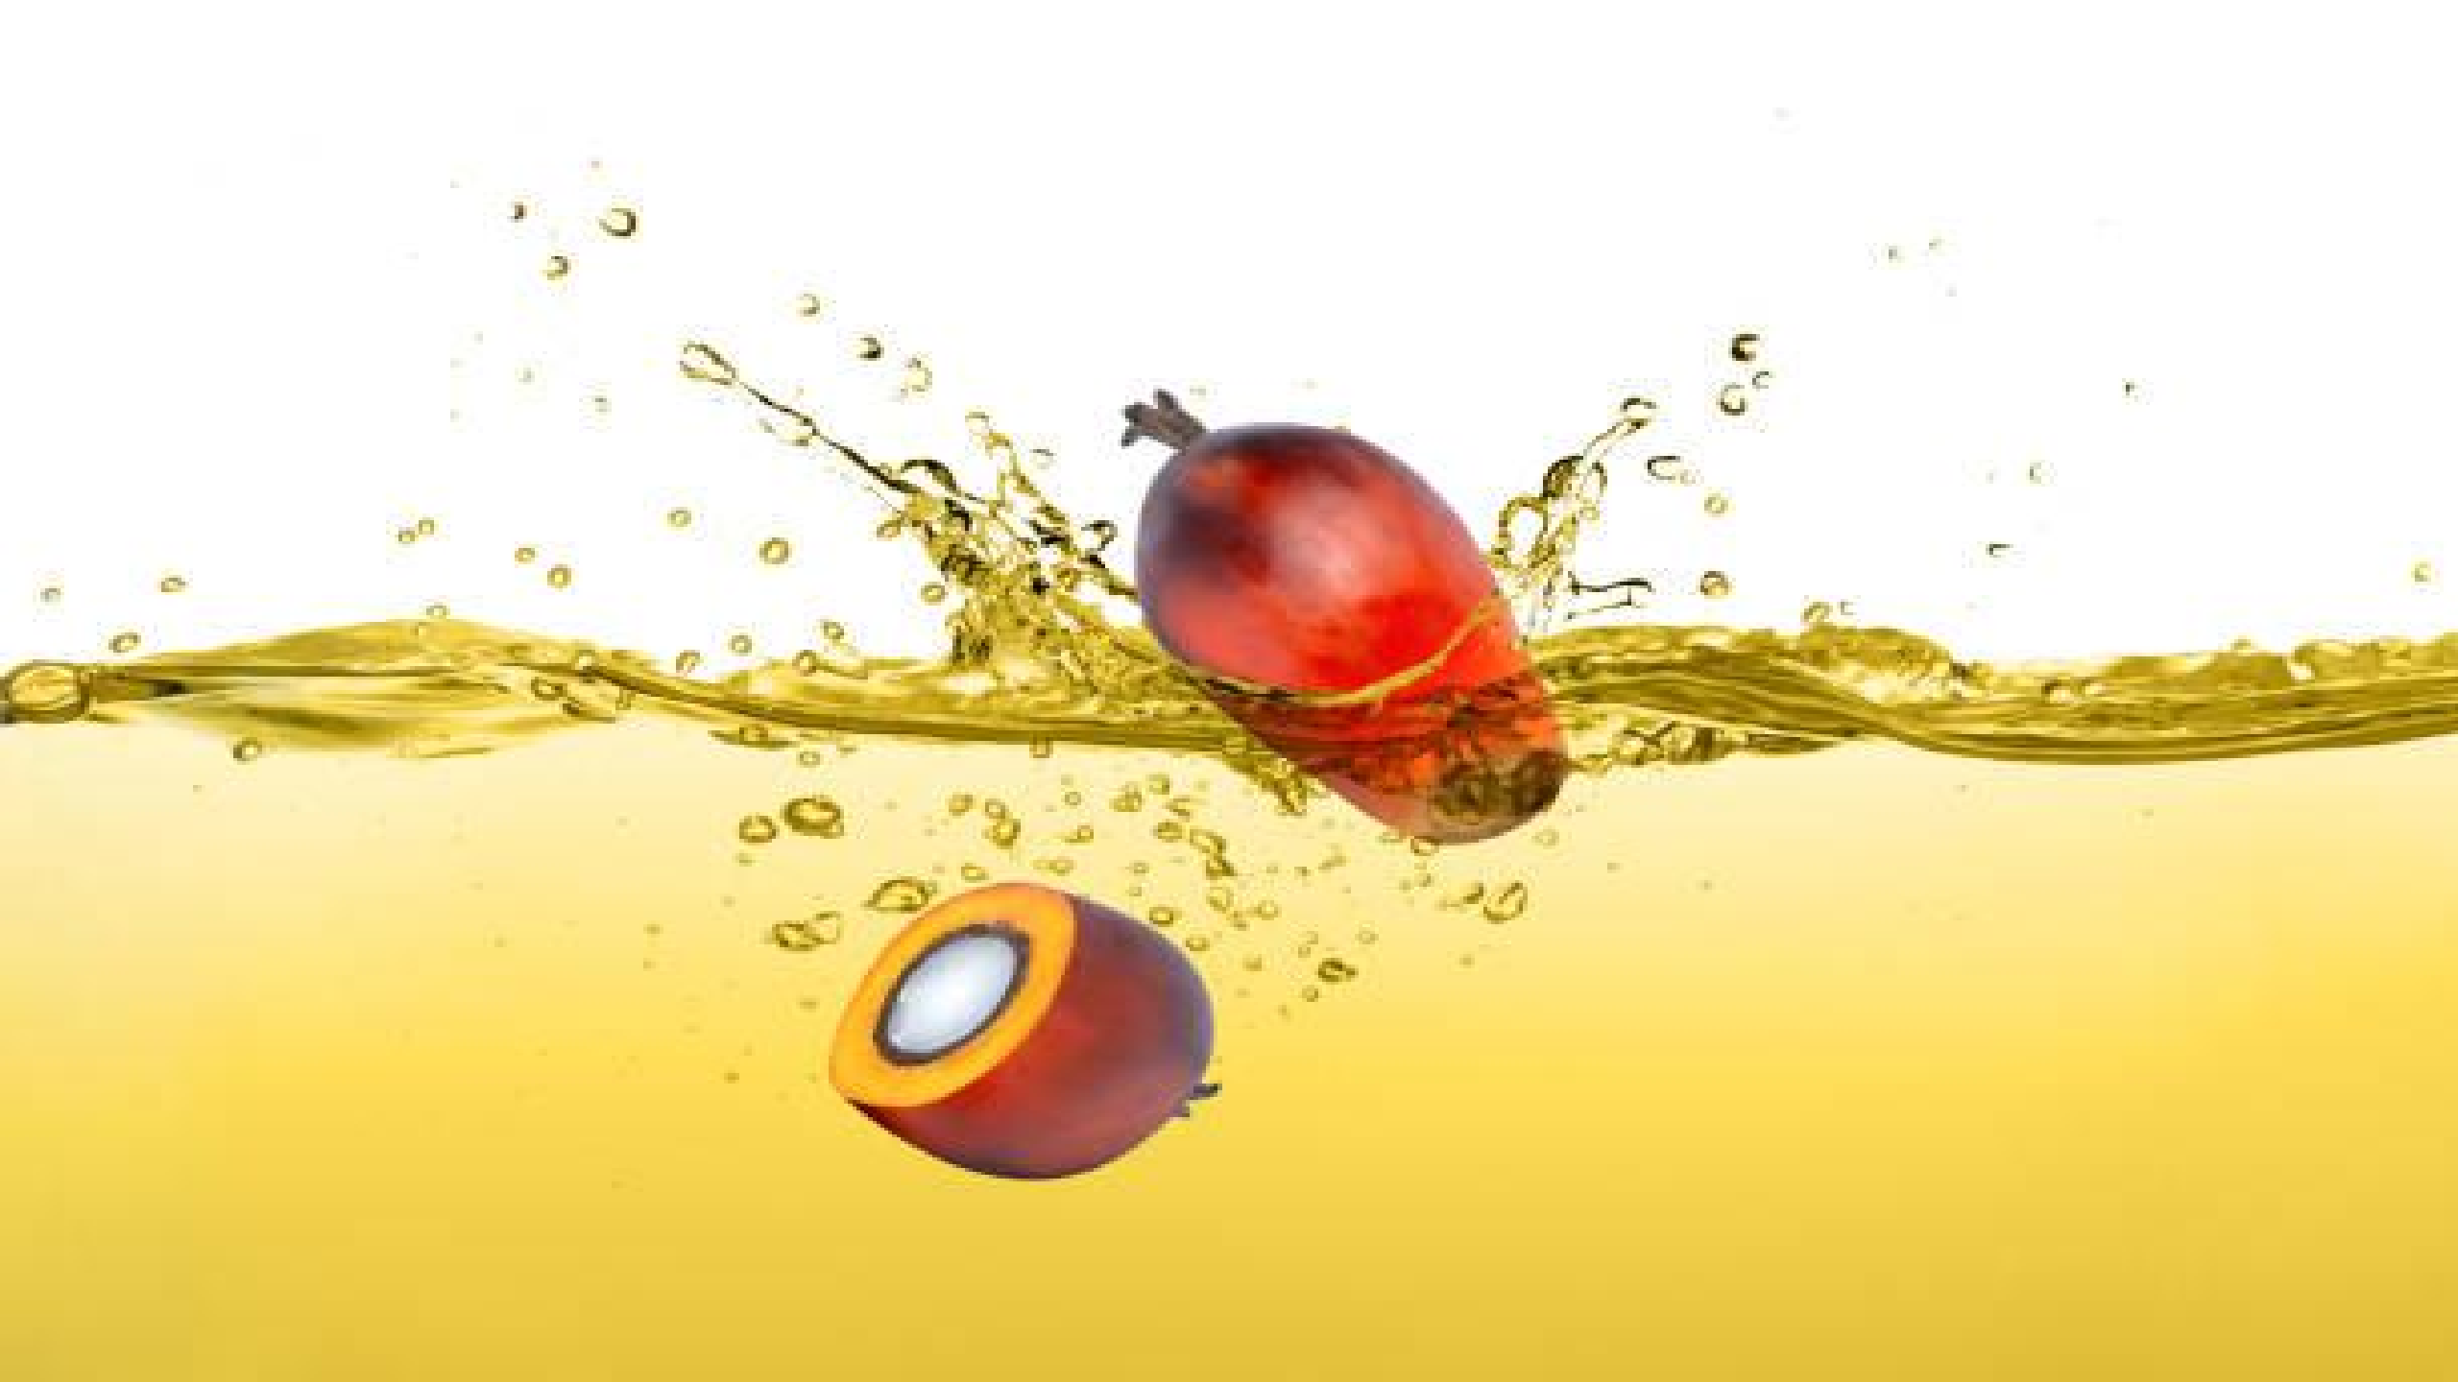

International Seminar
Sustainable Production of Healthy Vegetable Oils: Policies & Process to Achieving SDGs
Organized by:
Faculty of Food, Nutrition and Home Sciences (UAF) &
The Embassy of The Republic of Indonesia, Islamabad-Pakistan
10 MAY 2023
SERENA HOTEL FAISALABAD

Slide 3

GLOBAL CHALLENGES
Economic challenges in the consumer countries like Pakistan.
High Inflation.
Government intervention for price control.
GMO/Non-GMO issues in Pakistan on Oilseeds import.
Frequent changes in the Indonesian policies towards Edible Oils.
Climate Change.
Currency Depreciation.
(Pakistan currency remained extremely vulnerable like many other currencies of the world. We have seen depreciation to the extent of 25% - 30% which has enormously increased our landed cost.)
Increase in FED Funds Rate which is currently 4.50% to 4.75%.
Monetary tightening to restrict the liquidity to reduce inflation.
Global growth is projected to fall from an estimated 3.4 percent in 2022 to 2.9 percent in 2023, then rise to
3.1 percent in 2024. The rise in central bank rates to fight inflation and Russia’s war in Ukraine continue to weigh on economic activity. The rapid spread of COVID-19 in China dampened growth in 2022, but the recent reopening has paved the way for a faster-than-expected recovery. Global inflation is expected to fall from 8.8 percent in 2022 to 6.6 percent in 2023 and 4.3 percent in 2024, still above pre-pandemic
(2017–19) levels of about 3.5 percent.

Slide 4

PAKISTAN EDIBLE OIL SCENARIO
Per Capita Consumption | Around 20 kgs.
Total Consumption | Around 4.4 Million Tons
Local Production | Around 0.50 Million Tons
Import of Edible Oils | Around 3.00 Million Tons
Import of Oilseeds | Around 3.00 Million Tons
Oil Extracted from Imported Seeds | Around 0.90 Million Tons

Slide 5
IMPORT OF EDIBLE OILS IN PAKISTAN
(BASIS ARRIVAL) IN M.TONS
FOR JANUARY-DECEMBER 2021, 2022 AND JAN-FEB 2023
Product | 2021 | 2022 | JAN-FEB 2023
OLEIN | 1,567,847 | 1,249,814 | 349,882
RBDPO | 1,370,888 | 1,413,911 | 230,594
CPO | 60,749 | 47,999 | 10,000
CDSBO | 92,650 | 205,579 | 37,400
TOTAL | 3,092,134 | 2,917,303 | 627,876

Slide 6

PERCENTAGE OF PALM OIL PRODUCTS
FROM INDONESIA AND MALAYSIA IMPORTED
DURING JANUARY-DECEMBER 2021, 2022 AND JAN-FEB 2023
IN M.TONS(BASIS ARRIVAL)
Year | Indonesia % | Malaysia %
2021 | 89 | 11
2022 | 90 | 10
JAN-FEB 2023 | 87 | 13

Slide 7
GRAPH PERCENTAGE OF PALM OIL PRODUCTS FROM INDONESIA AND MALAYSIA IMPORTED DURING JANUARY-DECEMBER 2021, 2022 AND JAN-FEB 2023 IN M.TONS (BASIS ARRIVAL)
100
89
90
87
90
80
70
60
50
40
30
20
11
10
13
10
0
2022
Indonesia
2021
JAN-FEB 2023
Malaysia

Slide 8
PRODUCTION OF MAJOR OILSEEDS CROP
2020-2021 Production | 2021-2022 Production
Oilseed | Oil | Oilseed | Oil
(000 Tons) | (000 Tons)
Cotton Seed | 1782 | 214 | 2126 | 255
Rapeseed | 338 | 108 | 377 | 121
Sunflower Seed | 87 | 33 | 141 | 54
Canola Seed | 49 | 19 | 79 | 30
Total |  | 374 |  | 460
Source: Pakistan Oilseed Development Board
Economic Survey of Pakistan
For the season 2022-23, we are having bumper Rapeseed Crop and will have good quantity of indigenous Rapeseed Oil.

Slide 9
IMPORT OF OILSEEDS IN PAKISTAN BASIS ARRIVAL IN M. TONS
Product | 2021 | 2022 | JAN-FEB 2023
Soybeans | 2,553,818 | 1,789,424 | 67,368
Canola/Rapeseed | 833,639 | 610,786 | -
Total | 3,387,456 | 2,400,210 | 67,368
Soybeans imports decreased by 29.14% in 2022 over 2021 due to ambiguity of GMO / Non-GMO.
Pakistan have covered 540,000 Canola / Rapeseed and 40,000 MT Sunflower for Mar-Oct 2023.
Few Soybean consignments which were bought for spot and forward position have been washed out as Government
not allowing import of GMO Oilseeds presently.
Canadian Canola Seeds have been swapped with Australian Non-GMO Canola Seeds and Black Sea Rapeseeds.

Slide 10

MARKET FACTS
Let us see where the Market could head on the basis of the following facts:
Description | 2021 (Million Tons) | 2022 (Million Tons) | Expected in 2023 (Million Tons)
Malaysian Palm Production | 18.1 | 18.5 | Around 19.1
Indonesian Palm Production | 46.89 | 46.72 | Around 48.5
U. S. Soybean Crop | 114.75 | 121.5 | Around 116.4
Argentina Soybean Crop | 46.2 | 43.9 | 30 – 32
Brazil Soybean Crop | 140 | 130 | 150-152
Indian Imports of Edible Oils | (Nov-Oct) 13.13 | (Nov-Oct) 14.02 | (Nov22-Jan23) 4.34 Compared to 3.60 in (Nov2-Jan22) i.e. up by 31.56%
Bangladesh Imports of Edible Oils | 2.10 | 2.27

Slide 11

MARKET FACTS
Malaysian Stocks of Palm Oil in January 2023 were 2.268 million tons.
The highest we have seen on MDEX was RM 8172 on 1st March 2022 and the lowest was RM 3145 on 28th September 2022 that is swing of around 159.84% which is indeed an unprecedented swing within six months which no one can anticipate.
Frequent changes in the Indonesian policies create huge uncertainties in the palm prices. Their ambiguous announcements on DMO, B-30/35, export ratio of 1:6 and trading on their exchange create huge vulnerability in the market.
Recent floods in the Johor area of Malaysia may create uncertainty in the short term.
Soya Oil / Soybean complex remain very uncertain due to various reasons. Argentina’s expected production of around 30/32 million is too low but on the same context Brazilian production is expected to be better which can mitigate Argentinian shortfall to some extent.
Canadian Canola crop which was extremely compromised during last year, is showing some better results but unfortunately Pakistan cannot buy for the time being due to Canadian Canola being GMO.
Apart from China and India which have the biggest appetite, countries like Pakistan ,Bangladesh, Turkey, Egypt are having some economic challenges which has slowed down the destination demand for these countries.

Slide 12





FORECAST
“ When everything is clear……….nothing is clear.”
The market facts being deliberated upon, do give us certain directions.
At current Global prices, parity at destination is reasonable and it is good time for buyers to buy. This will be a sustainable factor for markets to remain stable.
During my virtual presentation in Globoil in Sep’22, and presentation in IPOC in Nov’22, I humbly pointed out that it will be very difficult for the MDEX to stay below RM 3,500 and this proved correct. While Global inflation is indeed very challenging, I still feel MDEX to range between RM 3,800 to RM 4,200 till June 2023, primarily due to uncertainty in Indonesian policies, floods, markets being supply specific & Argentina issues.
However, July onwards markets have the potential to go down further.

Slide 13


Slide 14






THANK YOU
FAAD WAHEED
Chief Executive, Fauji Supreme
Director, Waheed Group of Companies
Senior Vice President ICCI

